Slide 1
A Service-based Query Rewriting Algorithm
Daniel A S Carvalho, Magellan, IAE, Univ. J. Moulin Lyon 3, France
Chirine Ghedira-Guegan, Magellan, IAE, Univ. J. Moulin Lyon 3, France
Nadia Benani, LIRIS-CNRS, INSA-Lyon, Univ. Lyon, France
Genoveva Vargas-Solar, CRNS, LIG-LAFMIA, France

Slide 2
Agenda
Context and challenges
Previous work
Ongoing work: query rewriting algorithm
Conclusions and Future works
Notes:
The agenda of my presentation...

Slide 3
Context and Challenges
Data integration x Cloud computing
Classical data integration scenario
Query
Result
Mediator
Data source A
Data source B
Data source C

Slide 4
Quality oriented data integration
Query
Result
(Quality preferences)
Mediator
Data provider A
SLA
Data provider B
SLA
Data provider C
SLA
Notes:
Now we can see a new scenario for data integration... where we have different data providers A, B and C geographically disposed on different clouds. In the cloud scenario quality aspects are defined and agreed between the service provider and the service customer through contracts.
Service level agreements (SLA) is an example of these contracts.
As in the classical scenario we have a query that must be answered and this query is submitted to a mediator who will rewrtite it in accordance with the different data providers and the result will be integrated to be sent back to the user.
In this scenario we have some limitations and challenges such as:
* we have different SLAs schemas exported by the providers
* we have different level of SLAs... such as SLAs between the user and the data provider, SLA between the data provider and the cloud, and also SLAs between different data providers..
* we have different measures in different SLAs which have the same meaning
considering this new scenario, the use of SLA on data integration approaches is an open challenge and we believe that the quality on this approaches can be enhanced

Slide 5
Quality oriented data integration
Query
Result
Which services should I select? Are the requirements being respected?
(Quality preferences)
How to be sure that all SLAs are being respected?
Mediator
How to integrate different SLAs associated to services with user’s preferences?
How results can be reused for a next query?
In this new scenario, we believe that the quality on data integration could be enhanced by using SLA contracts
Data provider A
SLA
Data provider B
SLA
Data provider C
SLA
Notes:
Now we can see a new scenario for data integration... where we have different data providers A, B and C geographically disposed on different clouds. In the cloud scenario quality aspects are defined and agreed between the service provider and the service customer through contracts.
Service level agreements (SLA) is an example of these contracts.
As in the classical scenario we have a query that must be answered and this query is submitted to a mediator who will rewrtite it in accordance with the different data providers and the result will be integrated to be sent back to the user.
In this scenario we have some limitations and challenges such as:
* we have different SLAs schemas exported by the providers
* we have different level of SLAs... such as SLAs between the user and the data provider, SLA between the data provider and the cloud, and also SLAs between different data providers..
* we have different measures in different SLAs which have the same meaning
considering this new scenario, the use of SLA on data integration approaches is an open challenge and we believe that the quality on this approaches can be enhanced

Slide 6
Example in the medical scenario
Marcel is a user that wants to retrieve information about infected patients, patients’ dna information and patients’ personal information.
Family of services:
Services that retrieve infected patients given a disease: A
Services that retrieve dna information given a patient: B
Services that retrieve personal information given a patient: C
Query: dna information and personal information from patients that were infected by flu.
Naturally, he needs to call the services A, B and C in sequence.

Slide 7
Example in the medical scenario
Depending on the amount of services the cost of producing all possible compositions is high.
Not always the quality of these composition is good enough.
B
B
A
A
C
A
C
A
A
C
C
B
B

Slide 8
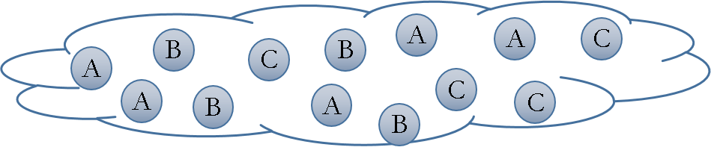

Which services should I select? Are the requirements being respected?
Example in the medical scenario
User can express his quality aspects expected while integrating services such as “Marcel wants to retrieve information about patients’ dna information and patients’ personal information using services that have availability higher than 98%, price per call less than 0.2 dollars, and total cost less then 1 dollar”
How to be sure that all SLAs are being respected?
How to integrate different SLAs associated to services with user’s preferences?
How results can be reused for a next query?
Query
Cloud SLA
Cloud SLA
Cloud SLA

Slide 9
Objective
The objective is to propose a data integration solution in a multi-cloud environment guided by user preferences and SLA exported by different clouds.

Slide 10
Previous work
Systematic Mapping on SLA-guided data integration in a multi-cloud environment
Discover open issues and limitations of existing works

Slide 11
Previous work
Trends and open issues on SLA guided multi-cloud data integration show that
Quality understood by the user and the cloud provider must be integrated under the same vision, in this case the SLA’s
SLA assessment must be integrated within the whole data integration process
Data integration classification scheme that
characterizes a:
modern vision of data integration in multi-cloud environments
enhanced by including SLAs in its process
is supported by the analysis of the literature considering the most popular paper databases and applying the SM method
Notes:
Trends and ....
So the contribution of this paper is a data integration classification scheme that:
-characterizes a:
Is supported by ...

Slide 12
Work in progress
Query rewriting is the core of data integration solutions
Different algorithms proposed to different domains
Early steps on developing our algorithm
Our solution is now working on a single cloud
Configuring a multi-cloud infrastructure to test our algorithm

Slide 13
Rhone service-based query rewriting algorithm
Problem addressed: given a set of abstract services, a set of concrete services, a user query and a set of quality preferences
Derive a set of service compositions that answer the query and fulfil the quality requirements.

Slide 14
Rhone service-based query rewriting algorithm
Originality:
The user can express her quality preferences and associate them to her queries
Service’s quality aspects are defined on Service Level Agreements (SLA) guide service selection and the whole rewriting process

Slide 15
Rhone service-based query rewriting algorithm
Steps:
Select candidate concrete services
Create mappings from concrete services to the query (Concrete service description - CSD)
Combine CSDs
Produce rewritings

Slide 16
Rhone service-based query rewriting algorithm (Formalization)
Input data: (1) a query; and (2) a list of concrete services
Definition 1 (Query):
Abstract services: basic service capabilities

Slide 17
Rhone service-based query rewriting algorithm (Formalization)
Input data: (1) a query; and (2) a list of concrete services
Definition 1 (Query):
Head variables
Local variables

Slide 18
Rhone service-based query rewriting algorithm (Formalization)
Input data: (1) a query; and (2) a list of concrete services
Definition 1 (Query):
Constraints over the input and output parameters

Slide 19
Rhone service-based query rewriting algorithm (Formalization)
Input data: (1) a query; and (2) a list of concrete services
Definition 1 (Query):
User preferences over the services

Slide 20
Rhone service-based query rewriting algorithm (Formalization)
Input data: (1) a query; and (2) a list of concrete services
Definition 1 (Query):
C and P are in the form: name operation value
<, >, ≤, ≥, ≠ and =

Slide 21
Rhone service-based query rewriting algorithm (Formalization)
Example:
Single measure: availability, price per call, price per request, response time, location, provenance, etc.
Composed measure: total price or cost which are computed by adding price per call and price per request values of all services included in the service composition. Total response time is computed by adding the response time of all services included in the service composition.
Quality Preferences P (or measures) can be:
Single measure: static measure associated to the service
Composed measure: dynamically computed measures associated to a rewriting. It is based on aggregations of single measures

Slide 22
Rhone service-based query rewriting algorithm (Formalization)
Abstract Services Available
Abstract Service | Description
DiseaseInfectedPatient (d?; p!) | Given a disease d, it retrieves patients p
DiseaseInfectedPatient (d?; p!, op!) | Given a disease d, it retrieves patients p, and op is an optional boolean output indicating if the operation proceeded well or not.
PatientDNA (p?; dna!) | Given a patient p, it retrieves DNA dna
PatientPersonalInformation (p?; info!) | Given a patient p, it retrieves patient’s personal information info
To illustrate the definitions, let us suppose a use case in the medical scenario
The user is able to query infected patients, dna information and personal information
Consider the following pre-defined abstract services

Slide 23
Rhone service-based query rewriting algorithm (Formalization)
The user wants to retrieve patient’s personal and DNA information who were infected by a disease «K» using services that have availability higher than 98%, price per call less than 0.2 dollars, and total cost less then 1 dollar.
Q(disease?; patientInfo!, dna!) := DiseaseInfectedPatient (d?; p!), PatientPersonalInformation (p?; info!), PatientDNA (p?; dna!), d = “K” [availability > 98, price per call < 0.2, total cost < 1]

Slide 24
Rhone service-based query rewriting algorithm (Formalization)
Definition 2 (Concrete services):
Head variables
Abstract services
Quality measures associated to the services
Local variables

Slide 25
Rhone service-based query rewriting algorithm (Formalization)
S1(a?;b!) = DiseaseInfectedPatient (a?;b!) [availability > 98]
S2(a?;b!) = DiseaseInfectedPatient (a?;b!) [availability > 98, price per call = 0.2]
S3(a?;b!) = DiseaseInfectedPatient (a?;b!) [availability > 98, price per call = 0.1]
S4(a?;b!) = PatientPersonalInformation (a?;b!) [availability > 98, price per call = 0.1]
S5(a?;b!) = PatientDNA (a?;b!) [availability > 99, price per call = 0.1, location = “close”]
S5(a?;b!) = DiseaseInfectedPatient (a?;c!), PatientPersonalInformation (c?;b!) [availability > 99, price per call = 0.1]
S5(a?;b!,c!) = DiseaseInfectedPatient (a?;p!), PatientPersonalInformation (p?;b!), PatientDNA (p?;c!) [availability > 99, price per call = 0.1]
According to the example, let us suppose the following concrete services:

Slide 26
Rhone service-based query rewriting algorithm (Formalization)
Definition 3 (measures matching):
All single measures in the query must exist in the concrete service, and all of them can not violate the measures in the query.
Definition 4 (abstract service matching):
An abstract service A can be matched with an abstract service B only if
(a) they have the same name; and
(b) they have a compatible number and type of variables

Slide 27
Rhone service-based query rewriting algorithm (Formalization)
Definition 5 (concrete service matching):
A concrete service can be matched with the query if all its abstract services satisfy the abstract service matching problem and all the single measures satisfy the measures matching problem.

Slide 28
Rhone service-based query rewriting algorithm (Formalization)
S1(a?;b!) = DiseaseInfectedPatient (a?,b!) [availability > 98]
S2(a?;b!) = DiseaseInfectedPatient (a?,b!) [availability > 98, price per call = 0.2]
S3(a?;b!) = DiseaseInfectedPatient (a?,b!) [availability > 98, price per call = 0.1]
S4(a?;b!) = PatientPersonalInformation (a?,b!) [availability > 98, price per call = 0.1]
S5(a?;b!) = PatientDNA (a?,b!) [availability > 99, price per call = 0.1, location = “close”]
S5(a?;b!) = DiseaseInfectedPatient (a?,c!), PatientPersonalInformation (c?,b!) [availability > 99, price per call = 0.1]
S5(a?;b!,c!) = DiseaseInfectedPatient (a?,p!), PatientPersonalInformation (p?,b!), PatientDNA (p?,c!) [availability > 99, price per call = 0.7]
Considering our concrete services in the example:

Slide 29
Rhone service-based query rewriting algorithm (Formalization)
Definition 6 (concrete service description):
Describes how a candidate concrete service can be used in the query rewriting process.
It includes:
Mappings from variables in a concrete service to variables in the query
Mappings from variables on the head of a concrete service to variables on its body
A set of abstract services that represents partially or fully the abstract services in the query
A set of quality constrains associated to the concrete service.

Slide 30
Rhone service-based query rewriting algorithm (Formalization)
Definition 6 (concrete service description):
A CSD is represented by an n-tuple:
‹S, h, ϕ, G, P›
S is a concrete service.
h are mappings between variables in the head of S to variables in the body of S.
ϕ are mapping between variables in the concrete service to variables in the query.
G is a set of abstract services covered by S.
P is a set quality constraints associated to the service S.

Slide 31
Rhone service-based query rewriting algorithm (Formalization)
Definition 6 (concrete service description):
Rule 1: head and local variables in the concrete service can be mapped to head variables in the query if they are from the same type
Rule 2: local variable in the concrete service can be mapped to a local variable in the query if: (i) they are from the same type; and (ii) the concrete service cover all abstract service in the query that depends on this variable. “Depends” here means that this local variable is used as input in another abstract service.
Q(a?;b!,c!) := S1(a?;b!) S2(p?;c!)

Slide 32
Rhone service-based query rewriting algorithm (Formalization)
S3(a?,b!) = DiseaseInfectedPatient (a?;b!) [availability > 98, price per call = 0.1]
S4(a?,b!) = PatientPersonalInformation (a?;b!) [availability > 98, price per call = 0.1]
S5(a?,b!) = PatientDNA (a?;b!) [availability > 99, price per call = 0.1, location = “close”]
S5(a?,b!) = DiseaseInfectedPatient (a?;c!), PatientPersonalInformation (c?;b!) [availability > 99, price per call = 0.1]
S5(a?,b!,c!) = DiseaseInfectedPatient (a?;p!), PatientPersonalInformation (p?;b!), PatientDNA (p?;c!) [availability > 99, price per call = 0.7]
Considering our example:

Slide 33
Rhone service-based query rewriting algorithm (Formalization)
S3(a?;b!) = DiseaseInfectedPatient (a?;b!) [availability > 98, price per call = 0.1]
S4(a?;b!) = PatientPersonalInformation (a?;b!) [availability > 98, price per call = 0.1]
S5(a?;b!) = PatientDNA (a?;b!) [availability > 99, price per call = 0.1, location = “close”]
S6(a?;b!,c!) = DiseaseInfectedPatient (a?;p!), PatientPersonalInformation (p?,b!), PatientDNA (p?;c!) [availability > 99, price per call = 0.7]
Definition 7 (valid rewriting):
A valid rewriting is a set of CSDs that:
Entirely covers the query
There is no CSD in duplicity
There are mappings for all variables
Rewritings:
Q(disease?; patientInfo!, dna!) = S3 (disease?;p!) S4 (p?; patientInfo!) S5 (p?;dna!)
Q(disease?; patientInfo!, dna!) = S6 (disease?; patientInfo!, dna!)

Slide 34
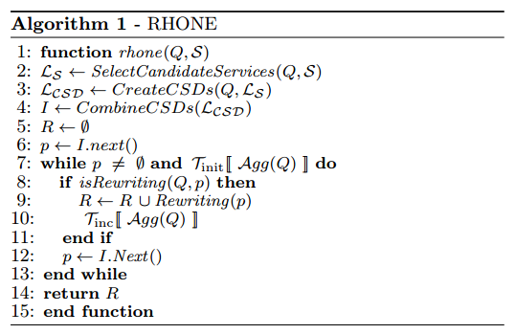
Rhone service-based query rewriting algorithm
Rewritings:
Q(disease?, patientInfo!, dna!) = S3 (disease?,p!) S4 (p?, patientInfo!) S5 (p?,dna!)
Q(disease?, patientInfo!, dna!) = S6 (disease?, patientInfo!, dna!)

Slide 35
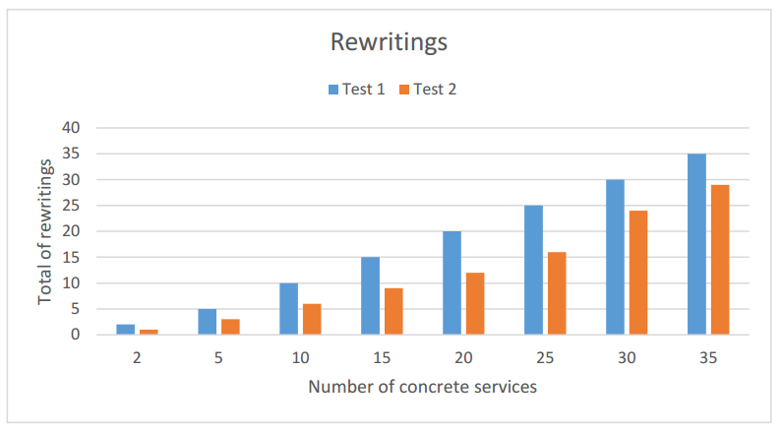
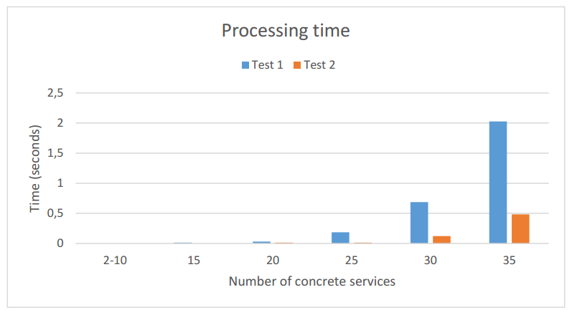
Preliminary results

Slide 36
Conclusions and Future works
Recall for the work done before
Systematic mapping and Article
The ongoing work concerning the algorithm
Optimizing the algorithm and producing experiments
Now are running examples until 100 services, and improving the implementation to run 1000 services in a low response time and memory consumption
Targeting ADBIS 2016

Slide 37
Thank you for your attention!
Questions? Opinions?
They are welcome! ☺

